Slide 1
/Shortest Job First
YOUR LOGO HERE
/Shortest Job First
Here is where the presentation begins
INDEX.HTML

Slide 2
/ What is Shortest Job First Scheduling?
YOUR LOGO HERE
Shortest Job First (SJF) is an algorithm in which the process having the smallest execution time is chosen for the next execution. This scheduling method can be preemptive or non-preemptive. It significantly reduces the average waiting time for other processes awaiting execution. The full form of SJF is Shortest Job First.
INDEX.HTML

Slide 3
types
YOUR LOGO HERE
basically two types of SJF methods
INDEX.HTML

Slide 4
Non-Preemptive SJF
YOUR LOGO HERE
/01
INDEX.HTML

Slide 5
Non-Preemptive SJF
YOUR LOGO HERE
/01
In non-preemptive scheduling, once the CPU cycle is allocated to process, the process holds it till it reaches a waiting state or terminated.
INDEX.HTML

Slide 6
Preemptive SJF
YOUR LOGO HERE
/02
INDEX.HTML

Slide 7
Preemptive SJF
YOUR LOGO HERE
/02
In Preemptive SJF Scheduling, jobs are put into the ready queue as they come. A process with shortest burst time begins execution. If a process with even a shorter burst time arrives, the current process is removed or preempted from execution, and the shorter job is allocated CPU cycle
INDEX.HTML

Slide 8
<EXAMPLE>
YOUR LOGO HERE
INDEX.HTML

Slide 9
In the table we have a process, arrival time, and burst time:
YOUR LOGO HERE
/Burst time6 | /Arrival Time | /Process
5 | 0 | P1
9 | 0 | P2
2 | 0 | P3
6 | 0 | P4

Slide 10

Here in the Gantt chart, the processes are arranged from smallest to largest:
P2 | P4 | P1 | P3

Slide 11
<OUR CODE>
YOUR LOGO HERE
INDEX.HTML

Slide 12
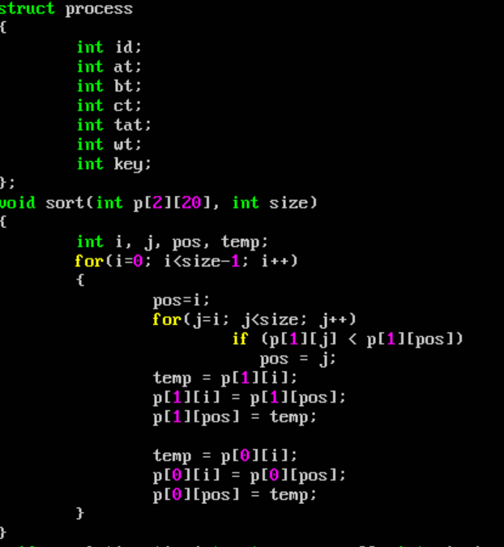
1.SORT

Slide 13
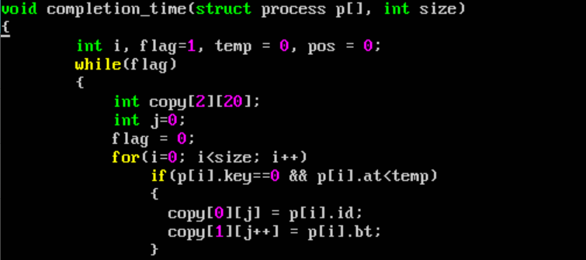
2.COMPLETION TIME

Slide 14
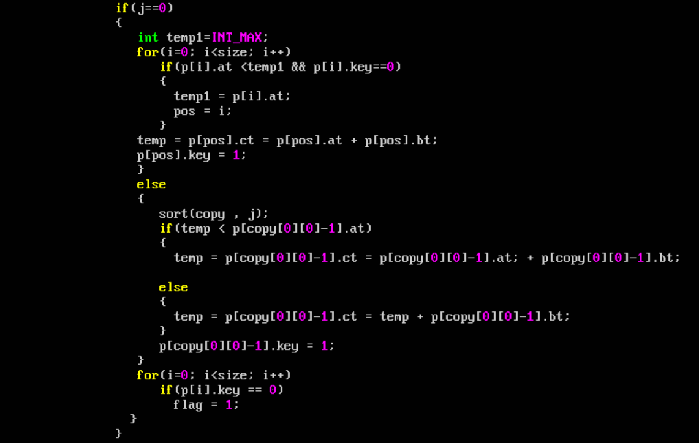

Slide 15
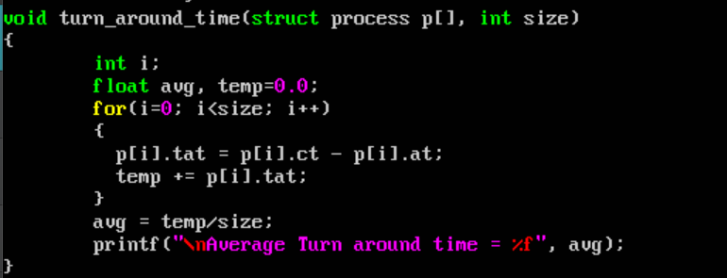
TURNAROUND TIME:

Slide 16
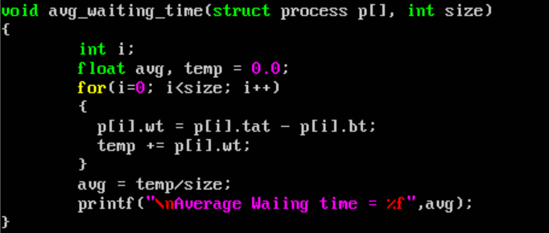
AVERGEWAITING TIME:

Slide 17
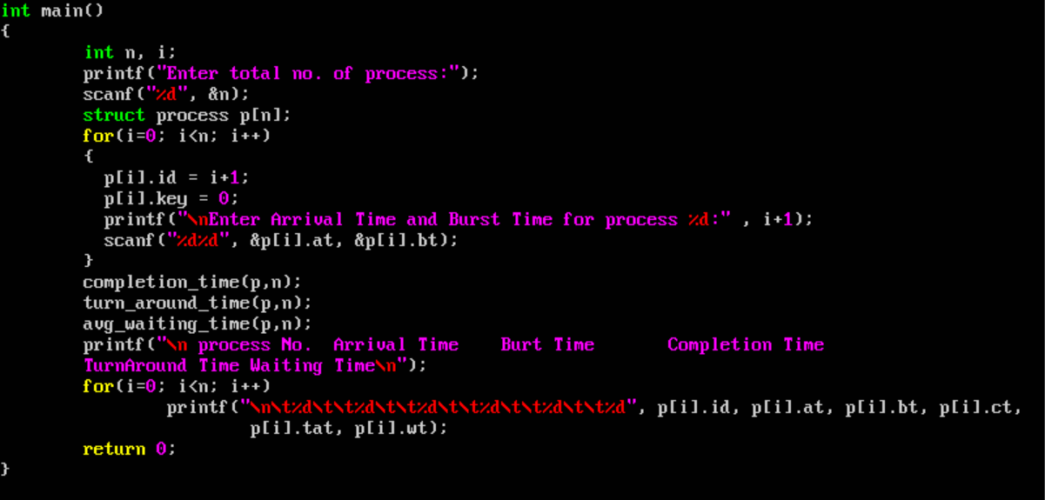
INPUT:

Slide 18
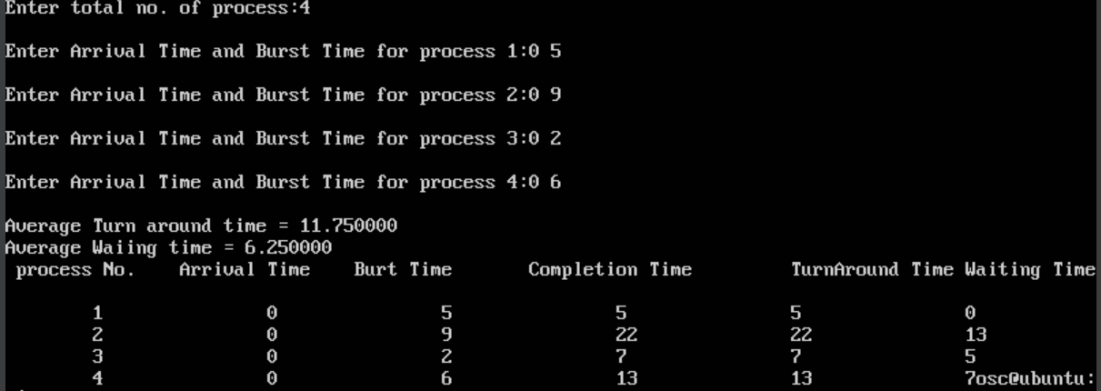
OUTPUT:

Slide 19
/END
YOUR LOGO HERE
{ “Thank you for listening”}
/END
INDEX.HTML

